Slide 1
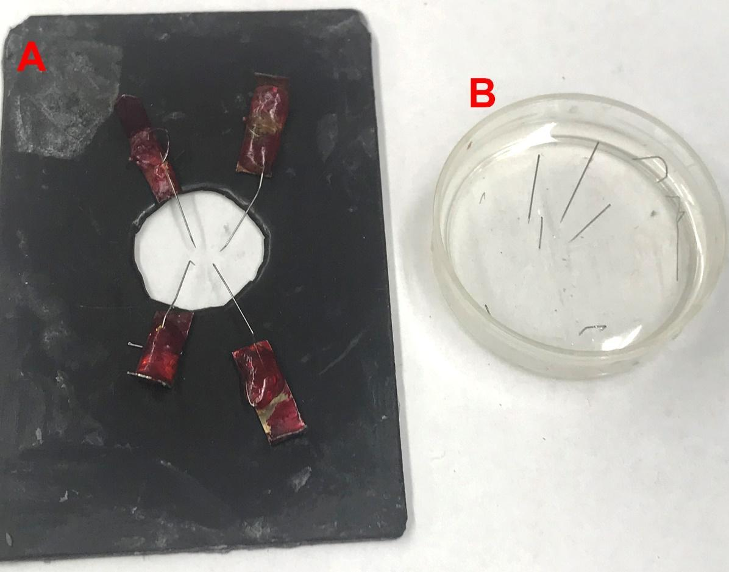
Authentic curriculum undergraduate research experimentation to learn about the effects of septicemia
on cardiac function: frog and larval Drosophila models
Jate Bernard¹, Melody Danley¹, Rebecca M. Krall², Katherine A. Sharp² and Robin L. Cooper¹
¹Dept. of Biology, Univ. of KY., Lexington, KY; .²Dept. of STEM, Univ. of KY., Lexington, KY.
ABSTRACT
Objectives
Students will learn:
How the frog heart is arranged anatomically compared to mammalian hearts.
The general anatomy of the cardiovascular system, relevant subsystems, and practical health-related terms associated with the cardiovascular system.
How the heart generates electrical activity and conducts electrical activity.
Types of septicemia and how they arise.
The effects of bacterial septicemia on the physiology of the body and general immune response.
The potential mechanism of action of LPS on heart rate.
Comparative cardiac physiology and immune response with insects and mammals.
Summary
Our educational module offers a new approach to studying cardiovascular function by utilizing a high-interest topic, effects of endotoxin-related septicemia (Lipopolysaccharides, LPS) from gram negative bacteria. Research on LPS is abundant in the area of neuroscience and neuromuscular junction activity. However, little is known on its effects in cardiac tissue. We have developed and piloted several hands-on laboratory exercises including simple heartbeat counts (HR) to more advanced electrical recording of diastolic and systolic periods with in-situ hearts. Furthermore, the laboratory module is highly flexible for virtual or in-person completion: we have adapted this module to both the frog and larval Drosophila melanogaster. The flexibility of this module also makes it adaptive to different classroom and laboratory settings, including CUREs courses. Utilization of comparative laboratory exercises combined with primary literature reviews can be used to foster a deeper understanding of the diversity of cardiovascular mechanisms possible among animals. Finally, this module contains pedagogical support for instructors interested in open inquiry and active learning approaches.
The frog preparation is amenable to student laboratories in physiology and for demonstrating pharmacological concepts to students. This preparation has been in use for over 100 years, and it still offers much as a model for investigating the generation and regulation of pacemaker rhythms and for describing the mechanisms underlying their modulation. This robust preparation is well suited to training students in physiology and pharmacology. The students will also learn to present data in graphical form for statistical analysis. The frog heart is very easy to expose with minimal dissection and the contractions are easy to record.
A novel twist in standard physiology laboratory teaching exercises in the use of insects or invertebrates to address cardiac function. Crayfish and crabs are easy to use for monitoring heart rate in the intact functioning animal (insects- Bellen et al., 2010 and Bier and Bodmer, 2004; crayfish-Bierbower and Cooper, 2009; crabs- Wycoff et al., 2018). Injection of LPS (Saelinger et al., 2019) or other substances such as serotonin or dopamine (Listerman et al., 2000) can also be performed. Injecting compounds into the intact animal will likely have an effect on various physiological systems, such as ventilation rate (Schapker et al., 2002; Shuranova et al., 2003) and not just the heart. Addressing how compounds might also have an effect on the autonomic nervous system in crustacean can be addressed as a comparative exercise in the autonomic nervous system of different animals (Choma et al., 2011; Shuranova et al., 2006). Annelids (i.e., worms and leeches) are also able to be used with exposed hearts for direct application of compounds (Bohrer 2006; Halfmann and Crisp, 2011; Stent et al., 1979).
If these experimental labs are to be performed each year or semester small variations can be implemented such as a different concentration of a substance or different strains of LPS, as there are many. At some point in time, it would be nice to report the effects of the various modifications so it may add to the scientific literature. By tweaking the procedure with varied compounds, the lab reports will not as likely be shared from student to student over the years as well.
METHODS
This module is divided into two main experimental procedures. One involves examining the effect of exposure to LPS on frog heats to determine if there is an acute effect on the heart rate. The second and more challenging activity is to determine if there is any effect by LPS exposure on the heart rate in larval Drosophila. The experimental exercises will be conducted following the protocol below. After the experimentation is completed, then the two lesson assignments can be completed and turned in along with the laboratory report.
Take home assignments to be turned in:
Lesson 1: frog and human
1. Draw the 3 chambered frog heart.
2. Draw the 4 chambered mammalian heart.
3. On the two hearts above label the chambers, septum, and list as well as draw on the heart the components for the electrical flow.
4. On the mammalian heart diagram, list out the average pacemaker rate for the various regions independent of each other.
5. Draw on the human heart where the parasympathetic and sympathetic innervation occurs and list where the neurons (part of the CNS) where the cell bodies reside.
6. Label on the frog and human heart (make new drawings) the direction of blood flow through the heart.
7. Diagram what is assumed to be the ionic regulation of a pacemaker cell in the mammalian heart.
8. Diagram the cellular process for cardiac muscle contraction beginning with electrical depolarization of the cell.
9. What is known to date in how mechanistically LPS might be directly altering the heartbeat?
Lesson 2: Drosophila
1. Draw the heart tube location within a larva of a Drosophila. Also, label if located on the dorsal or ventral side of the animal and associated tracheal tubes for help in locating the heart tube.
2. Draw where hemolymph will enter and how it flows through the heart tube, as well as the direction of flow. Label the values associated with the heart tube.
3. Label which part of the heart is considered the true heart as compared to the aorta of the heart tube. Label where the hemolymph leaves the heart tube out to the body cavity.
4. If the heart tube is cut between the true heart and aorta do the two parts beat at different rates? Does a human heartbeat at different rates in the atria and ventricle if the AV node conduction is blocked to the Bundle of HIS?
5. In the larval heart neurally innervated? Can hormones or compounds such as serotonin alter heart rate and, if so, does it increase or decrease the rate?
6. Does temperature alter the heart rate in larval Drosophila? If so, does it increase or decrease at colder environmental temperatures?
INTRODUCTION
Traditional undergraduate anatomy and physiology courses follow standard protocols for laboratory experimentation, partly because of the commercialization of student equipment and pre-packaged software. As a result, much student laboratory coursework utilizes similar experiments across colleges and universities, such as measuring lung volumes as a human respiration lab or measuring properties of the frog gastrocnemius muscle contractions as a skeletal muscle lab. While such laboratory exercises have been shown to increase the students’ understanding in factual concepts, chronic reuse of the same pre-packaged lab exercises raises many concerns, including reduced academic diversity, loss of critical thinking opportunities, transfer of completed worksheets directly among peers at the same institution or indirectly from other institutions (e.g. downloading completed reports from internet websites), and lack of student interest and motivation to complete the work (Henige, K., 2011: Esparza et al., 2020).
To increase student interest and motivation, foster critical thinking skills, and promote academic diversity and independence of student work, there is strong interest to develop effective course-based authentic undergraduate research experiences, or ACUREs (Bakshi, et al., 2016; Linn, 2015). Effective ACUREs also have the potential to empower students to communicate novel scientific findings to the scientific community, thus helping the student develop scientific communication skills as well as a sense of scientific identity (Staub et al. 2016; Esparza et al., 2020). Furthermore, there are now increased numbers of journals which promote peer-reviewed undergraduate research (e.g. Malloy et al., 2017). Such journals as IMPULSE (The Premier Undergraduate Neuroscience Journal. https://impulse.appstate.edu/issues/2017) and American Journal of Undergraduate Research (AJUR) are overseen by faculty with the emphasis on publications by undergraduates.
In this paper, we describe the development and implementation of a flexible mini-ACUREs within a pre-existing upper division animal physiology course, that utilized pre-existing equipment, standardized lab procedures and readily available software packages. The novelty of the project is the use of experimental treatments with unknown effects within the context of a traditional lab exercise: the effects of lipopolysaccharides (LPS) from gram-negative bacteria on the contractile properties of frog and Drosophila hearts. Further, new findings are of interest to the scientific community, since LPS is known to trigger illness in humans such as septicemia.
Frog heart
The frogs will be deemed unconscious and double pithed (brain and spinal cord) by the lab staff. The frogs will be placed in a dissection dish for participants to expose the heart to compounds for recordings of the heartbeat. The general procedures for dissection to expose the heart of frogs and set up are readily obtained on the internet and various comparative physiology laboratory manuals. We are following the general procedure supplied by ADI Instruments which accompanies the software package (CHART version 8.0) used for recording the heartbeat with the purchased force transducers from ADI Instruments. The protocol supplied by ADI was modified for this particular laboratory exercise.
Larval Drosophila Heart
The procedure to dissect and expose the heart to saline and other compounds are detailed in video format freely accessible at http://www.jove.com/index/details.stp?id=1596
Small dishes with elastomer bottoms for fine insect pins can be used or, if preferable, the glass slides with magnetic tape and mounted insect pins can be used (Figure 9). These dissection dishes will be provided to the participants. Either the larvae will be opened and the heart exposed ready for visual counting of the heartbeat, or one will need to learn to dissect the larvae. Drosophila larvae can be used easily by the 3rd instar or if other insect larvae are to be used, the dissections might need to be modified.
Details are provided on web page:
http://web.as.uky.edu/Biology/faculty/cooper/ABLE-2021/ABLE-2021-frog%20and%20Drosophila%20heart-LPS/Home-The%20effects%20of%20septicemia%20on%20cardiac%20function-%20frog%20and%20larval%20Drosophila%20models-ABLE%202021.htm
Piercing the apex with the hook as shown and slanting the frog and the dish to provide an alignment of the heart with the pull on the transducer.
References
Andrä J, Garidel P, Majerle A, Jerala R, Ridge R, Paus E, Novitsky T, Koch MH, Brandenburg K. 2004. Biophysical characterization of the interaction of Limulus polyphemus endotoxin neutralizing protein with lipopolysaccharide. European Journal of Biochemistry 271(10):2037-2046.
Bakshi A, Patrick LE, Wischusen EW. 2016. A framework for implementing course-based undergraduate research experiences (CUREs) in freshman biology labs. The American Biology Teacher 78(6):448–455.
Bier E, Bodmer R. 2004. Drosophila, an emerging model for cardiac disease. Gene 342:1–11.
Choma MA, Suter MJ, Vakoc BJ, Bouma BE, Tearney GJ. 2011. Physiological homology between Drosophila melanogaster and vertebrate cardiovascular systems. Disease models and mechanisms 4:411–420.
Esparza, D., A. E. Wagler, and J. T. Olimpo. 2020. Characterization of Instructor and Student Behaviors in CURE and Non-CURE Learning Environments: Impacts on Student Motivation, Science Identity, Development, and Perceptions of the Laboratory Experience. CBE Life Sciences Education 19: 1-15.
Henige, K. 2011. Undergraduate student attitudes and perceptions toward low- and high-level inquiry exercise physiology teaching laboratory experiences. Advances in Physiology Education 35: 197-205.
Linn MC, Palmer E, Baranger A, Gerard E, Stone E. 2015. Undergraduate research experiences: Impacts and opportunities. Science 347:1261757.
Makarevitch, I., C. Frechette, and N. Wiatros. 2015. Authentic research experience and “big data” analysis in the classroom: maize responses to abiotic stress. CBE Life Sciences Education 14: 1-12.
Staub, N. L., M. Poxleitner, A. Braley, H. Smith-Flores, C. M. Pribbenow, L. Jaworski, D. Lopatto, and K. R. Anders. 2016. Scaling Up: adapting a phage-hunting course to increase participation of first-year students in research. CBE Life Sciences Education 15: 1-11.
Larval Drosophila dissection dishes for exposing the heart. Glass slides with magnetic tape and mounted insect pins (A). Elastomer coated dish for fine insect pins to pin down the preparations (B).

